Slide 2
OWASP VXDF: Is that really vulnerable? Show me the VXDF!
MIHIR SHAH

Slide 3

$whoami
Hi, I’m Mihir Shah! 👋
I do security stuff @Google
❤️ Open Source
Speaker, Contributor, Trainer, Ex-Chapter Lead at OWASP & CNCF
Author - Cloud Native Software Security Handbook
Started as a Developer, now a Security Engineer

Slide 4
PRESENTATION TITLE
ON EVERYTHING ABOUT
APPLICATION SECURITY
The Problem: Detection Without Validation
Tools detect patterns, not proof.
Thousands of findings from SAST, DAST, SCA overwhelm teams.
Developers lose trust; triage effort skyrockets.
Critical issues get buried.

Slide 5
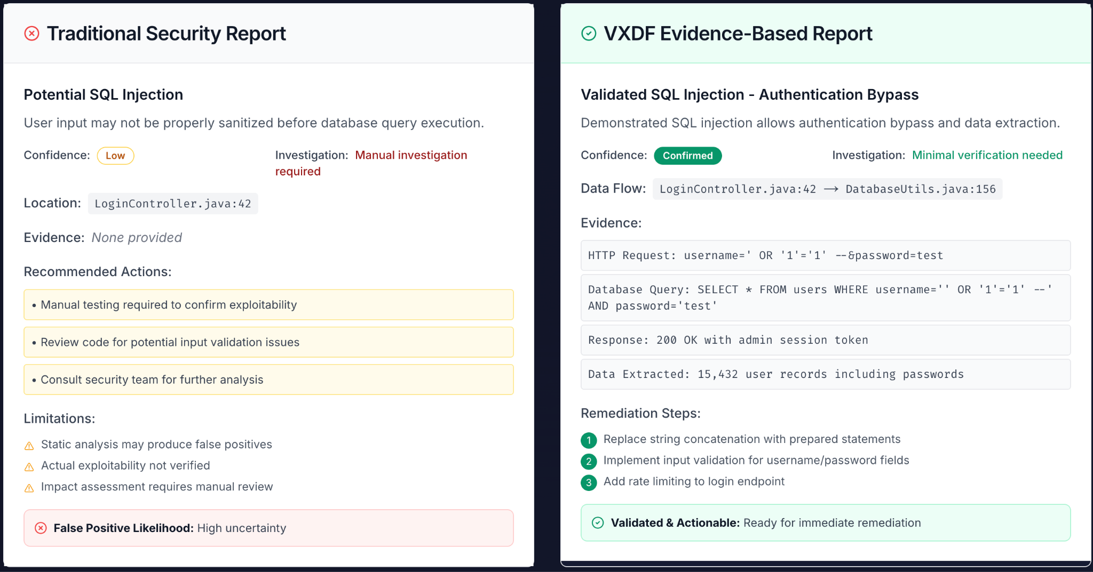
Fragmented Evidence: Each Tool Sees One Piece

Slide 6
Why Not OCSF, VEX, or CycloneDX?
Dimension | CycloneDX | VEX | OCSF | VXDF
Primary Goal | Enumerate software components & vulnerabilities | Declare vulnerability status | Normalize security telemetry/events | Represent evidence of exploitability
Data Nature | Static metadata | Static assertion (“affected”, “not affected”) | Event data (alerts, logs) | Dynamic validation (proof, trace, payload, environment)
Lifecycle Stage | Build / Release | Post-scan triage | Runtime detection | Post-validation / Evidence generation
Trust Model | Declarative (“we believe this”) | Declarative (“vendor asserts this”) | Observational (“we saw this”) | Empirical (“we proved this”)
Intended Consumers | Supply chain & inventory systems | Risk triage & vendors | SIEM / XDR pipelines | Validators, triagers, exploit analyzers
Data Sensitivity | Public-safe | Public-safe | Semi-sensitive | Potentially sensitive (payloads, traces, PoCs)

Slide 7
VXDF Core Model
Unify
Validate
Serialize
Ingest Findings from SAST, DAST, SCA, runtime telemetry.
Correlate through data-flow graph; verify exploit path
Weave evidence based on the vulnerability not the tool and provide a VXDF output

Slide 8
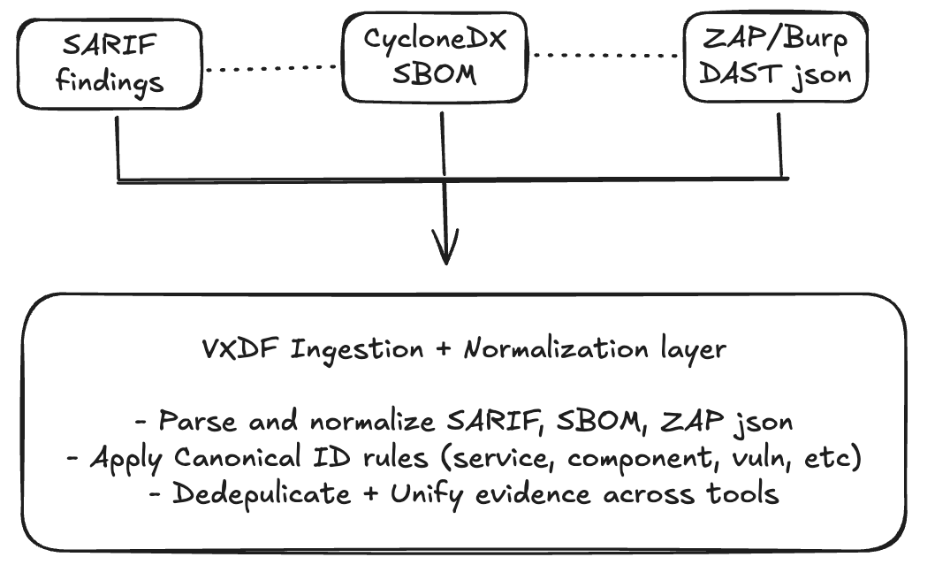
VXDF Graph RAG Reasoning loop

Slide 9
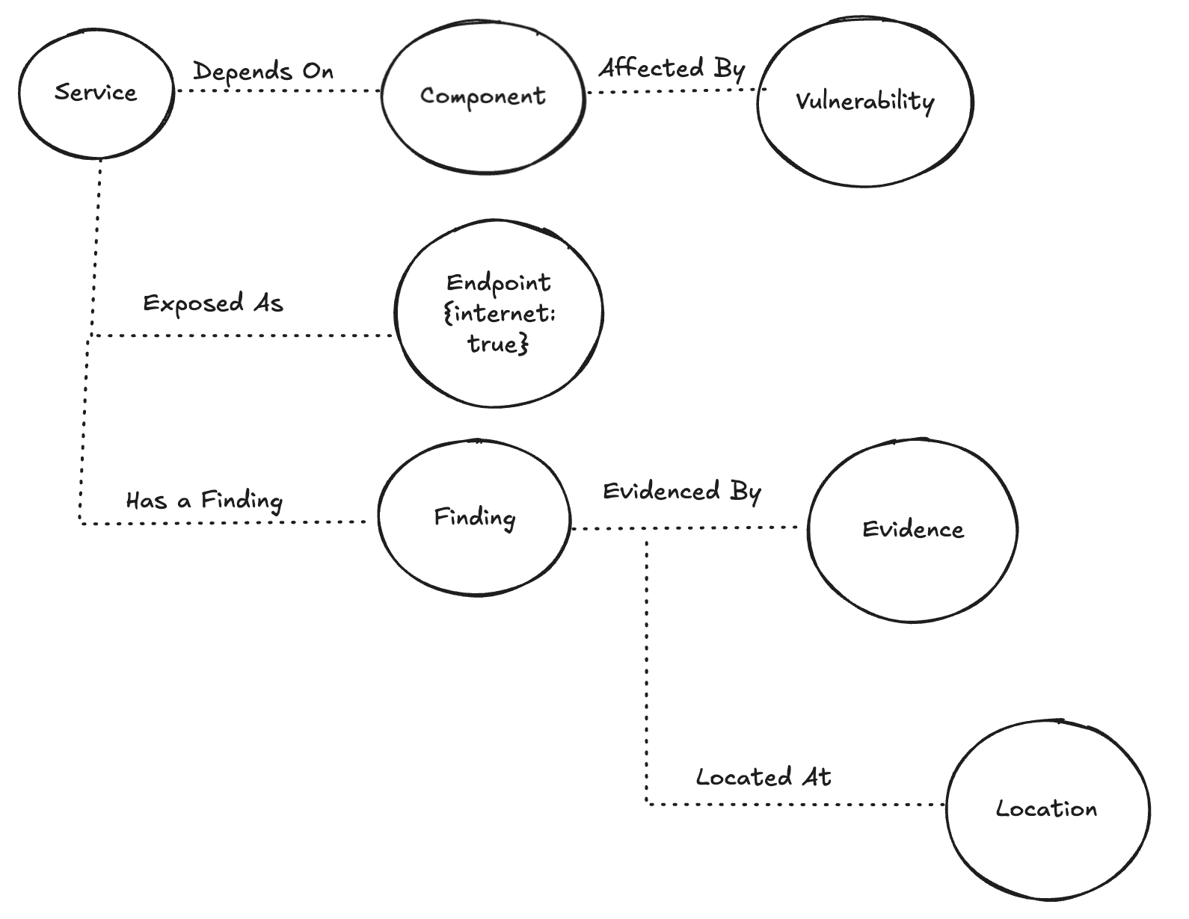
VXDF Knowledge Graph (Neo4j)

Slide 10
VXDF Graph-RAG Engine
Retriever (Cypher Plan Executor)
Verifier (Rubric Evaluator)
Serializer (VXDF Generator)
Queries Neo4j with Plan templates
Returns subgraph as EvidencePack
Applies MUST / BOOSTERS / MITIGATORS rules
Computes exploitability score + reasons
Assembles structured Answer → ExploitFlow JSON
Validates schema (vxdf json schema)

Slide 11

Lots of Jargon, but...
How does the tool map source/sink from SAST to DAST identified endpoints?
What do you mean by normalize SARIF, SBOM, DAST Json findings, how are we normalizing these findings?
How do we create the graph in Neo4j? how is the causality established?
Retriever queries Neo4j graph, how does it determine the query? WHO determines the query? how do you know what subgraph to pull and which is relevant to the vulnerability currently being analyzed?

Slide 12
SAST Source/Sink to DAST endpoint mapping
Compiled Route Tables/Routing Metadata
OpenAPI/Swagger - framework route docs
Stack trace log correlation
https://vxdf.org/blog/vxdf-engine-architecture

Slide 13
Normalize Findings
Unify naming (different scanners → one field taxonomy)
Canonicalize IDs (e.g., always pkg: PURL, always CVE-####, always lowercase paths)
Clean optional fields (nulls → “unknown”)
Tag provenance (SARIF vs CycloneDX vs ZAP)
Preserve lineage (so we know where each fact came from)
The result of normalization is a tool-agnostic record set that can safely be merged into a graph without collisions.

Slide 14
After Normalization - How VXDF creates the graph?
Graph Construction: The Core Entities (Nodes)
Each normalized record becomes one or more of the following nodes:
Service → The logical application or API
Component → A library, class, or module
Vulnerability → CVE/CWE or scanner rule
Finding → Scanner-specific detection instance
Evidence → Proof (payload, POC, runtime trace)
Endpoint → URL or HTTP path (for DAST)
Location → Code location (for SAST)
Control (optional) → Mitigations like WAF, IAM policies

Slide 15
Edges are created from semantic rules in VXDF’s schema.
Relationship | Meaning | Source
(:Service)-[:DEPENDS_ON]->(:Component) | service uses this component | CycloneDX SBOM
(:Component)-[:AFFECTED_BY]->(:Vulnerability) | component includes vulnerable version | CycloneDX vuln list
(:Finding)-[:ABOUT]->(:Vulnerability) | scanner detected this issue | SARIF, ZAP
(:Finding)-[:EVIDENCED_BY]->(:Evidence) | proof-of-exploit provided | SARIF message, ZAP evidence
(:Service)-[:EXPOSED_AS]->(:Endpoint) | endpoint is externally accessible | ZAP, config
(:Finding)-[:LOCATED_AT]->(:Location) | where in code vulnerability resides | SARIF
(:Endpoint)-[:PROTECTED_BY]->(:Control) | endpoint has mitigations | manual / config enrichment

Slide 16
So what do you mean by “causality”?
In VXDF, causality = validated data-flow linkage between source, vulnerable component, and proof.
For example:
SARIF says: unsanitized input at LoginController.java#L123
CycloneDX says: that code belongs to auth@1.4.2
ZAP says: endpoint /auth/login executes attacker-controlled input
Therefore, the engine infers a causal chain:
(Service: orders-api)
→ (Component: auth@1.4.2)
→ (Vulnerability: CWE-89)
→ (Evidence: ZAP payload)
That is a validated data flow — source → vulnerable component → sink → evidence.
That is the “causality basis” VXDF uses.

Slide 17
The Graph-RAG Retriever: How it Knows What to Query
The Retriever module answers contextual questions like:
“Is CVE-2024-0001 exploitable in orders-api?”
It doesn’t randomly query the graph, it uses predefined Plan templates (Cypher queries) described in VXDF Module 6 schema.
User query or automation trigger: vxdf_engine --query "Is CVE-2024-0001 exploitable in orders-api?"
The engine translates this into a Plan object:
{
"service_id": "orders-api",
"vuln_id": "CVE-2024-0001",
"cypher_templates": [
"MATCH p=(s:Service {service_id:$service_id})-[:DEPENDS_ON]->(c:Component)-[:AFFECTED_BY]->(v:Vulnerability {vulnerability_id:$vuln_id}) RETURN p",
"MATCH p=(f:Finding)-[:ABOUT]->(v:Vulnerability {vulnerability_id:$vuln_id}), (f)-[:EVIDENCED_BY]->(e:Evidence) RETURN p",
"MATCH p=(s:Service {service_id:$service_id})-[:EXPOSED_AS]->(ep:Endpoint {internet:true}) RETURN p"
]
}

Slide 18
The Graph-RAG Retriever: How it Knows What to Query (Cont.)
3. The Retriever executes these Cypher templates in Neo4j, substituting parameters (service_id, vuln_id)
4. It collects all connected nodes and edges that satisfy the plan into an EvidencePack:
{
"paths": [
Service → Component → Vulnerability,
Finding → Evidence → Vulnerability,
Service → Endpoint (internet=true)
],
"evidence_ids": ["sarif:fp-123", "zap:10021:evt-77"]
}
5. That EvidencePack goes to the Verifier, which applies the VXDF rubric to compute exploitability (MUST/BOOSTERS/MITIGATORS).

Slide 19



Call for Volunteers
Join the Github Discussions
Join the OWASP Slack Channel #project-vxdf
Join the weekly calls!

Slide 20
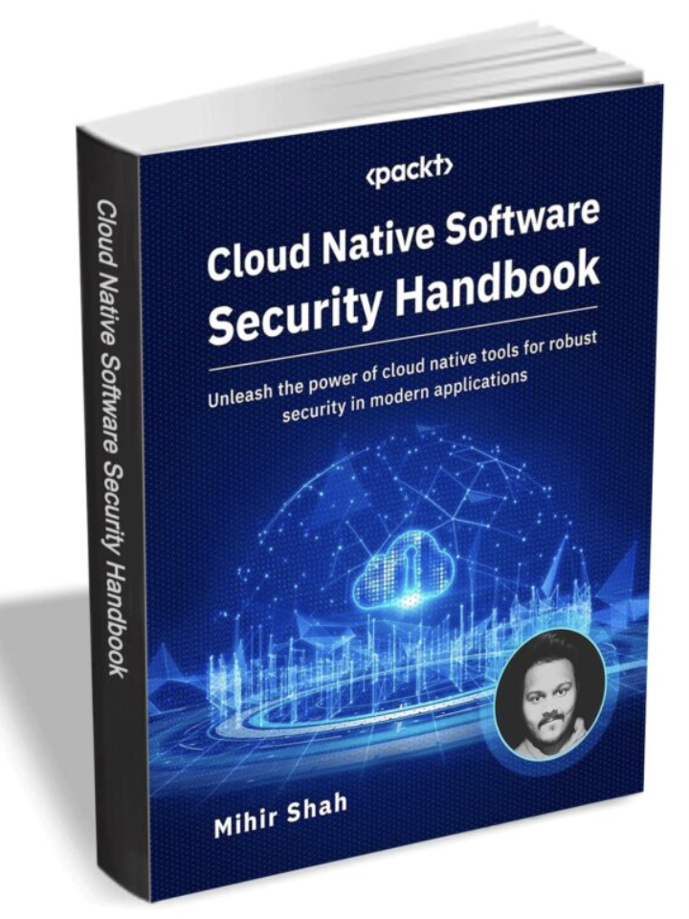
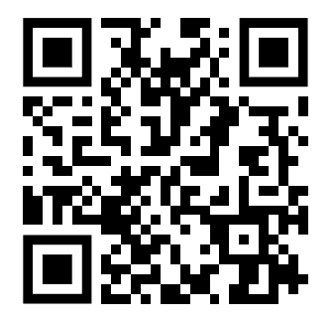
THANK YOU | Q&A

Slide 21
THANK YOU!

