Slide 1


Flutter based Instrument Cluster Demo App
Aakash Solanki ( GSoC” 22 Student)

Slide 2
Who am I?
Name: Aakash Solanki
College: Indian Institute of Technology Mandi
Github: aakash-s45
LinkedIn: aakash-s45
Experience:
Google Summer of Code Student at The Linux Foundation, AGL (Automotive Grade Linux)
Software Developer Intern at Samsung RnD Bangalore

Slide 3
Agenda
Flutter Application graphics side (Frontend)
Introduction to KUKSA.VAL (Backend)
Demo app on AGL demo platform

Slide 4
Instrument Cluster App: UI
To develop the graphics side of the app, Flutter is used.
Flutter is open source framework developed by Google to build multi-platform apps. With the latest release, apps for Linux and Windows can be developed.
Elements on UI side
  Gauges
  Turn Indicators
  Few Signals and Indicators
  Navigation Widget
    openstreetmap
    openrouteservice
  State management using riverpod

Slide 5
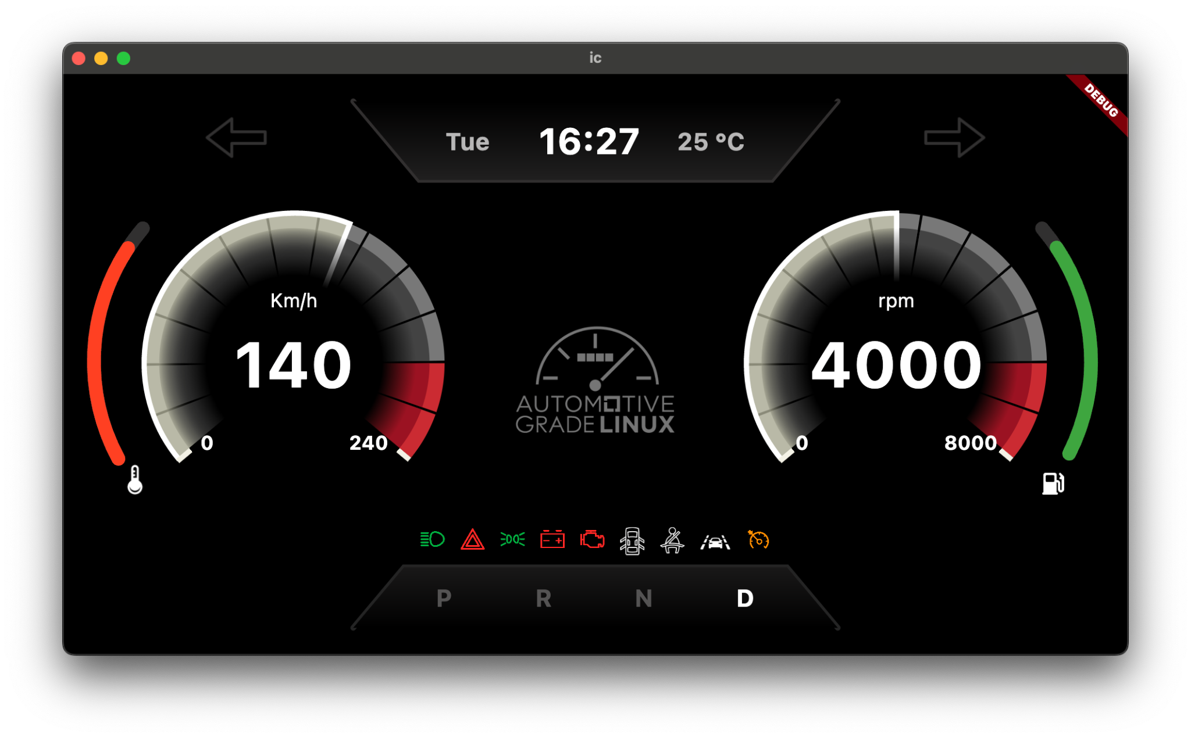
Instrument Cluster App: UI

Slide 6
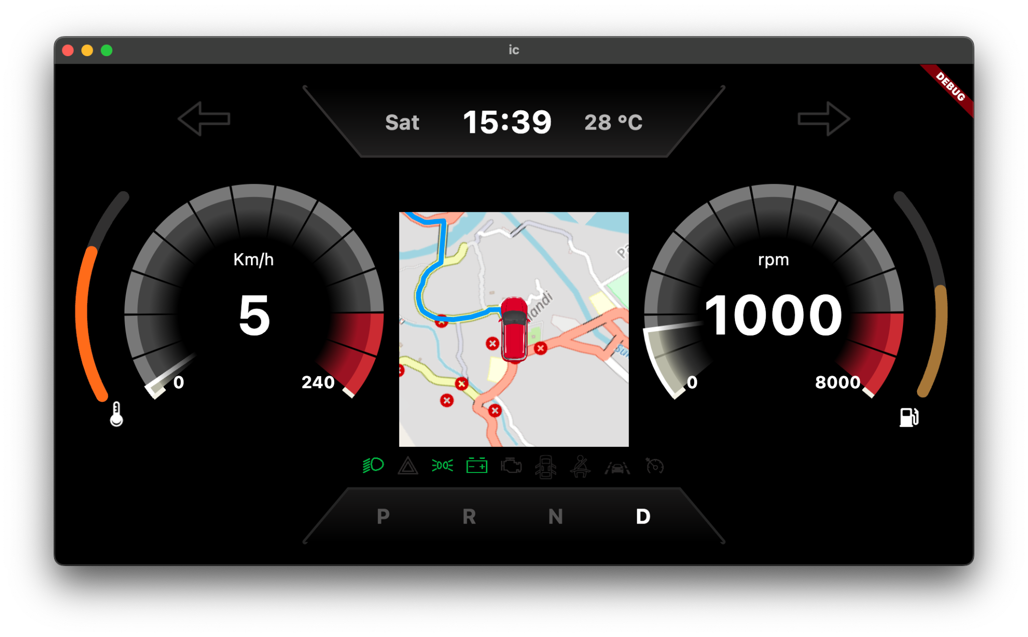
Instrument Cluster App: UI

Slide 7
What is kuksa-val-server?
It is the source of data for the instrument cluster app.
Kuksa-val-server is used to serve the vehicle data to the app over websockets.
It provides signals to the VSS data, we can subscribe to these signals, read these signals and write to these signals.
We can also add new signals to the VSS data.

Slide 8
Working of the app
Start the App
Check for config file
Connect to the kuksa-val-server
Listen stream for data
Home screen

Slide 9
Instrument Cluster App: UI

Slide 10
Instrument Cluster app: AGL demo platform
Add instrument cluster app to the AGL demo platform
Create new recipe and an image
To run the AGL version of the app
  Need openrouteservice account and API key
Detailed guide: docs.automotivelinux.org
Video Guide to build the app: YouTube Link

