Slide 1
1

Slide 2
CERL
Consortium of European Research Libraries
Marian Lefferts, Executive Manager
2

Slide 3
How the Consortium of European Research Libraries may support collections
with early printed books and manuscripts
BETH 2023
3 October 11:30-12:00

Slide 4
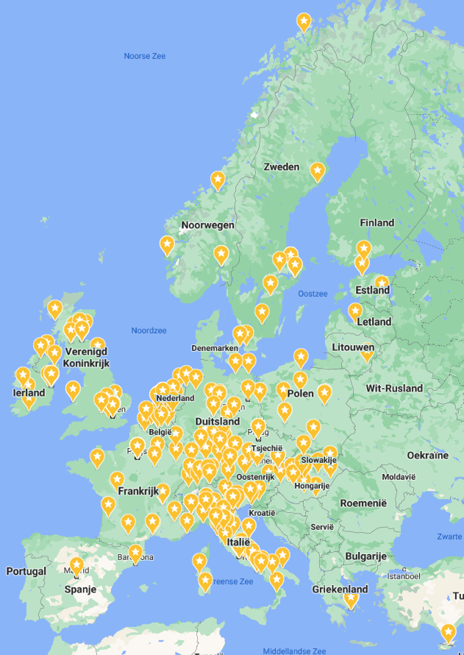



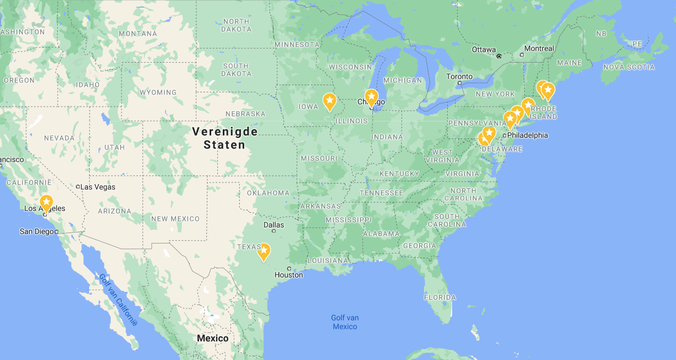
Since 1992
a membership organisation
with ca. 292 members

Slide 5
CERL
A network for humans
A hub for data
Connected to other heritage organisations
  LIBER, IFLA
  RBMS at ALA
  International Council on Archives (ICA) – CERL is represented on EGATTT
  Europeana, OCLC, DFG, etc
  And funding bodies: ERC, Polonsky, Lanckoroński, EU funding

Slide 6
A network for humans
Very active working groups on
HPB, CERL Thesaurus, Manuscripts and Incunabula
Engagement and Promotion
Provenance
Digital Humanities
Book binding
Security Network
Cultural Property
Retrospective National Bibliographies

Slide 7
A hub for data
Heritage of the Printed Book database (HPB) 1997-
CERL Thesaurus (CT) 2000-
Material Evidence in Incunabula (MEI) 2010-
Hosting 3rd party databases 2016-
CERL Provenance Digital Archive (PDA) 2018-
HPB Provenance 2022-
Discontinued:
CERL Portal for Manuscripts and Early Printed Books 2005-2020
Can-you-help? database 2006-2016

Slide 8

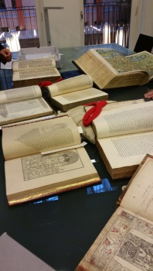
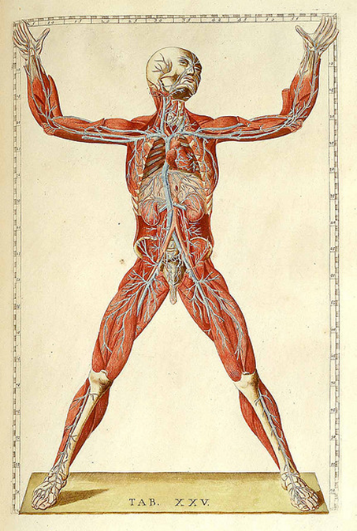
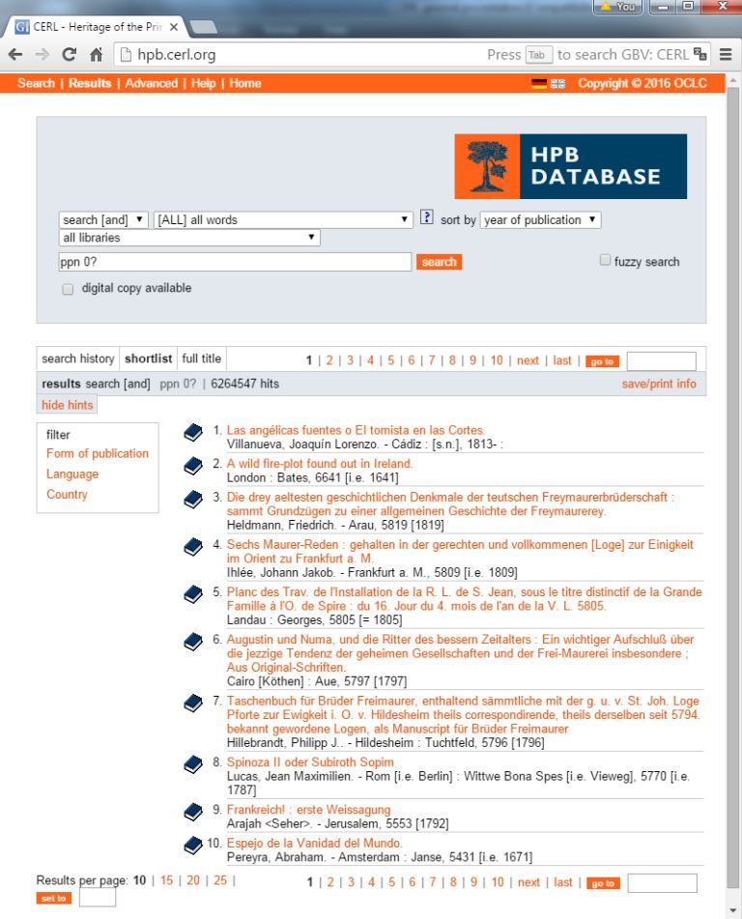

























http://hpb.cerl.org/
9.016.938 records
File contributions
(21 countries)

Slide 9
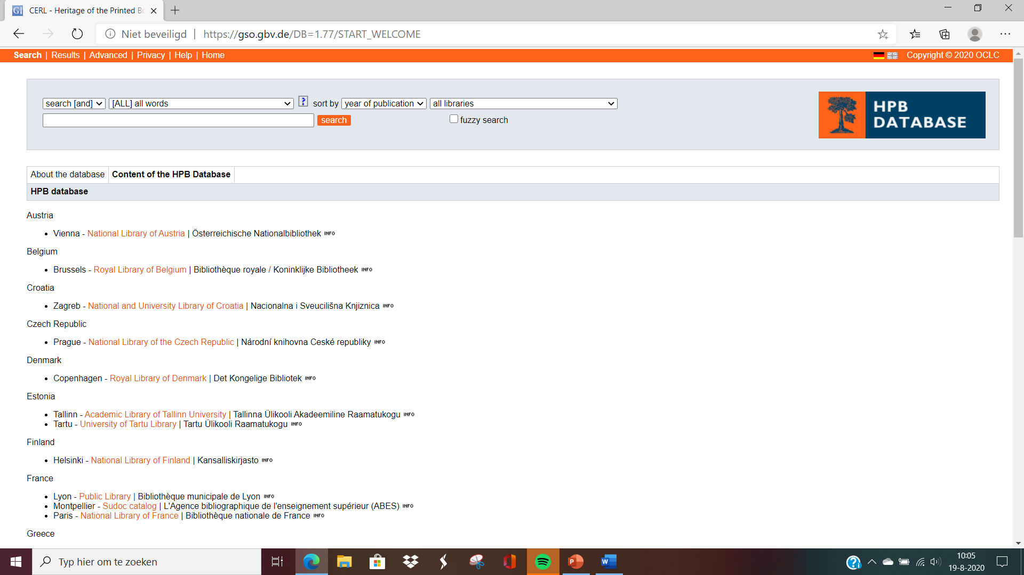
CERL prepared electronic records for M.S.G. McLeod, ed., and completed K.I. James and D. J. Shaw. The Cathedral Libraries Catalogue: Books printed before 1701 in the Libraries of the Anglican cathedrals of England and Wales: Volume II (Books printed on the Continent of Europe before 1701 in the libraries of the Anglican Cathedrals of England and Wales). London: Bibliographical Society and the British Library, 1984
And we have records for
- Canterbury Cathedral (Mendham Coll)
- Dunblan Cathedral, Scotland
- Lambeth palace

Slide 10
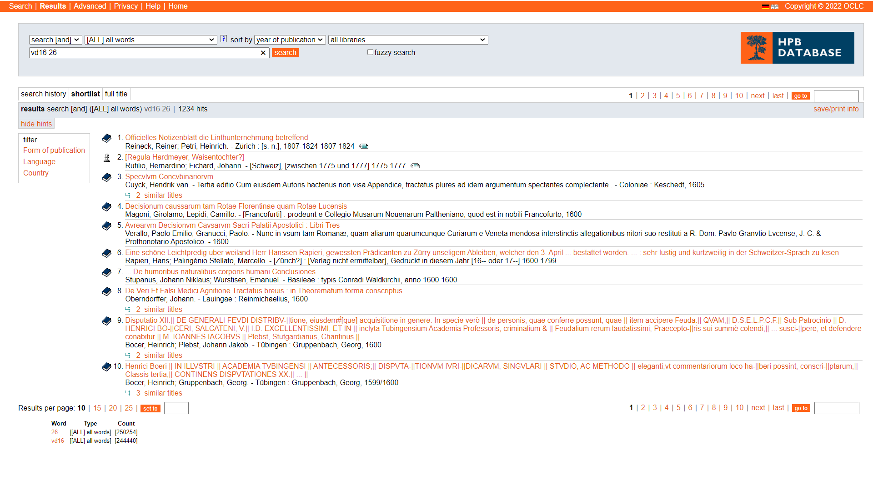
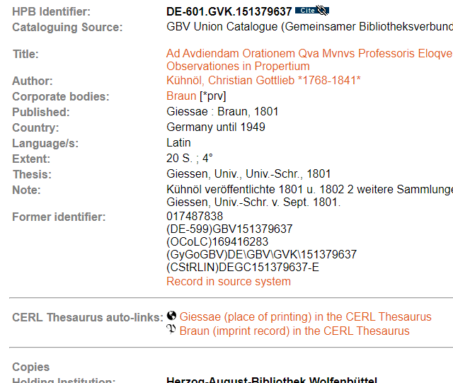


Slide 11

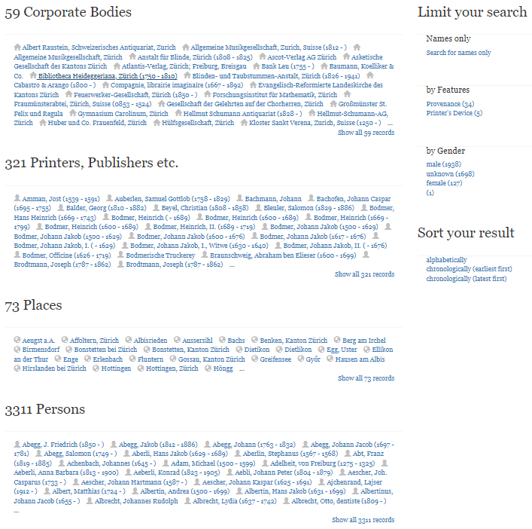
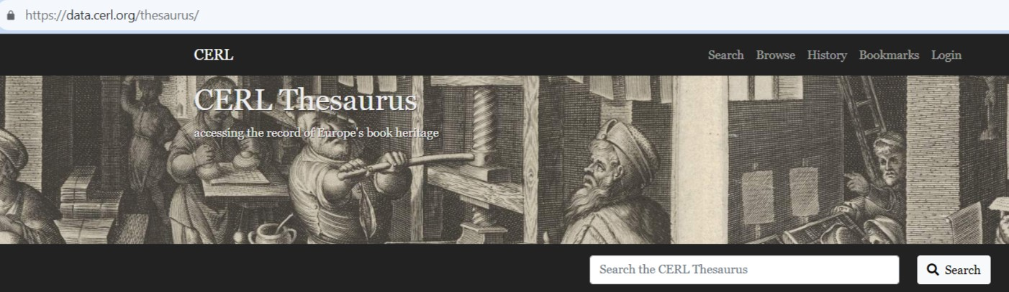
https://thesaurus.cerl.org/
https://data.cerl.org/thesaurus

Slide 12
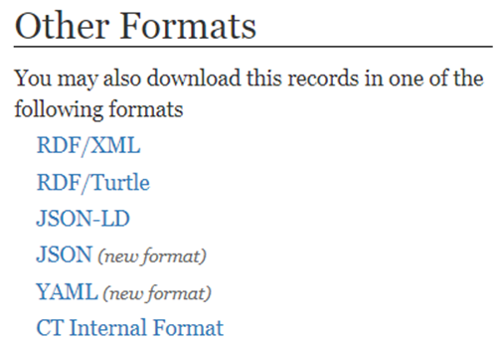










Includes information on provenances
Published as LOD, data downloadable
Extensive internal and external linking, e.g.
  Wikipedia
  Maps
  Kalliope
  GND
  Printers devices

Slide 13
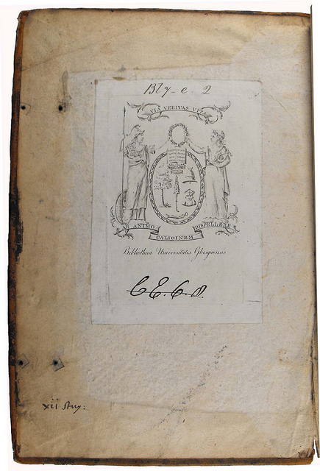
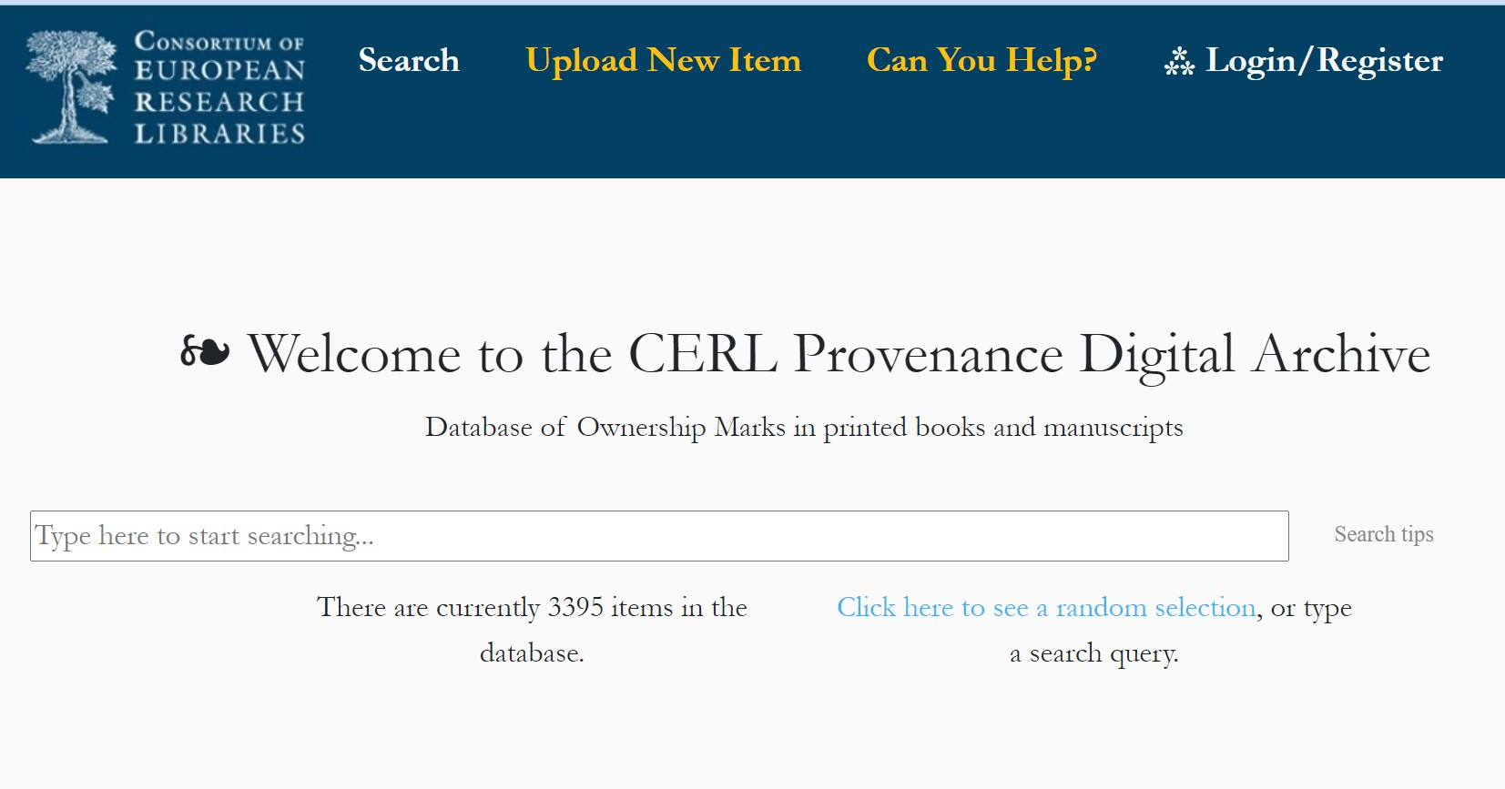
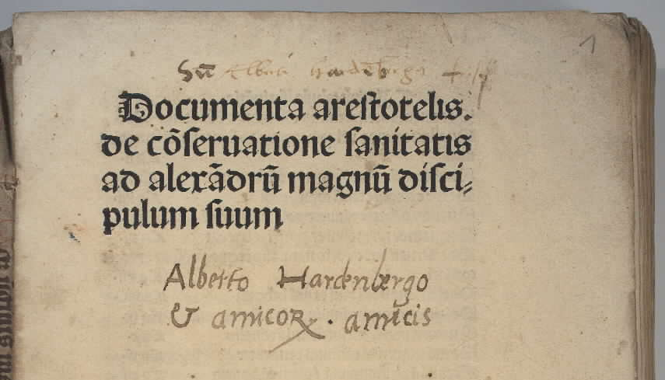
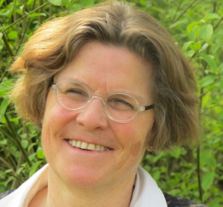
https://pda.cerl.org
With permission from University of Glasgow Library, Special Collections
Sp Coll Bl7-e.2
13

Slide 14
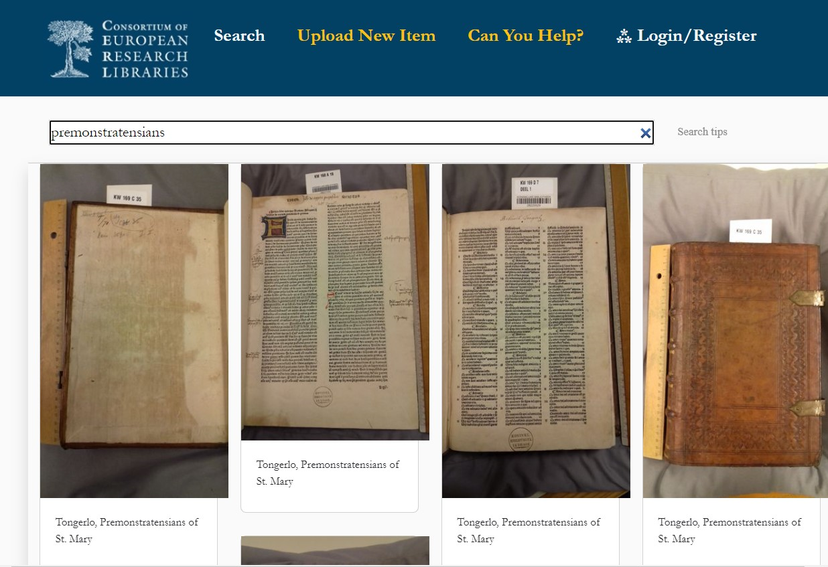
CC0 and IIIF compliant

Slide 15
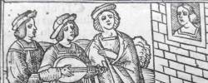
We want to connect data and put it in context
CERL has an infrastructure and the supporting interface to facilitate hosting of third-party datasets. Research projects that need to annotate bibliographical records are welcome us this new facility
Importance of the activity lies in the potential connections between datasets that CERL may exploit
CERL now hosts
ISTC and STCN
PATRIMONiT and Materia Medica
  Mainz Early Modern Academics’ Libraries
  Scottish Book-Trade Index
  General index of Siebmarchers Armorial
  Libro de los Epítomes and the Library of Hernando Colón
  (University of Copenhagen and the Seville Cathedral Chapter)

Slide 16
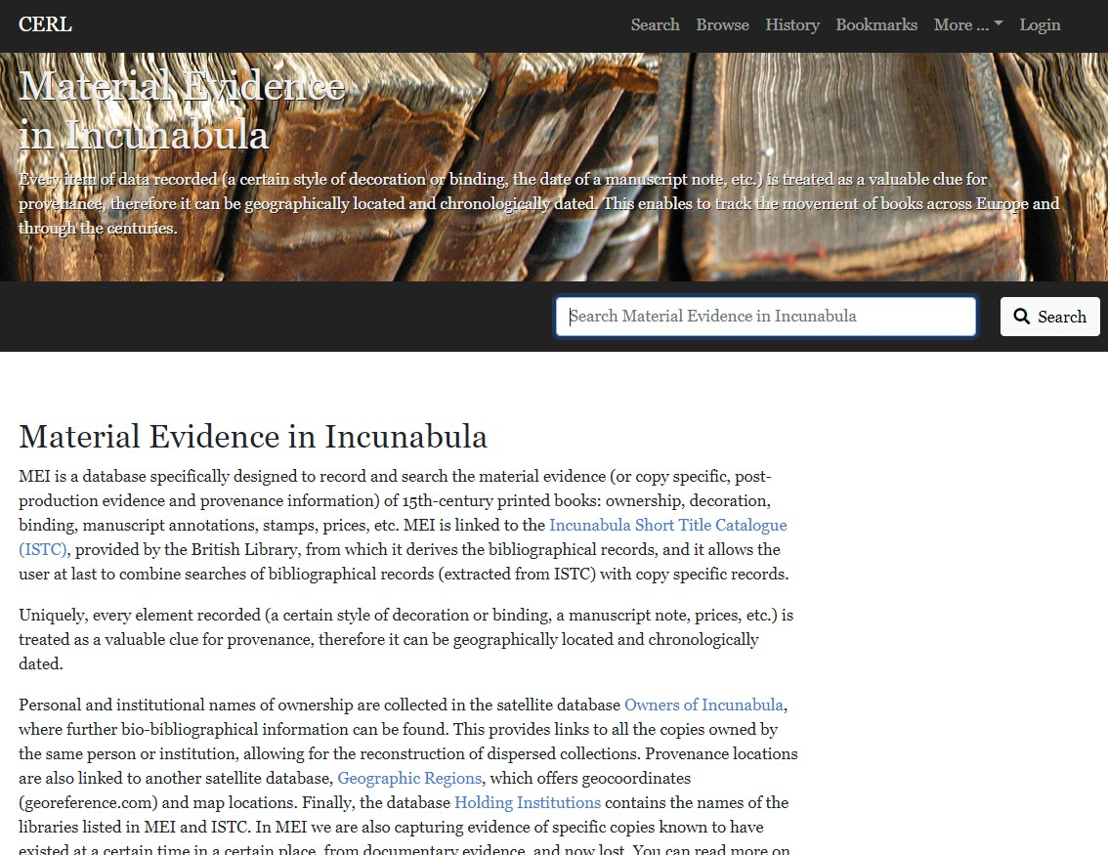
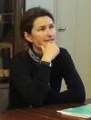



https://data.cerl.org/mei

Slide 17
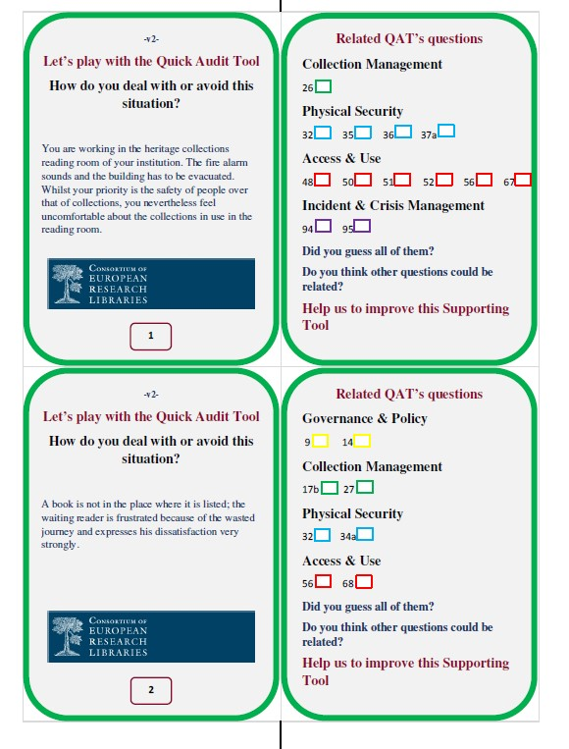
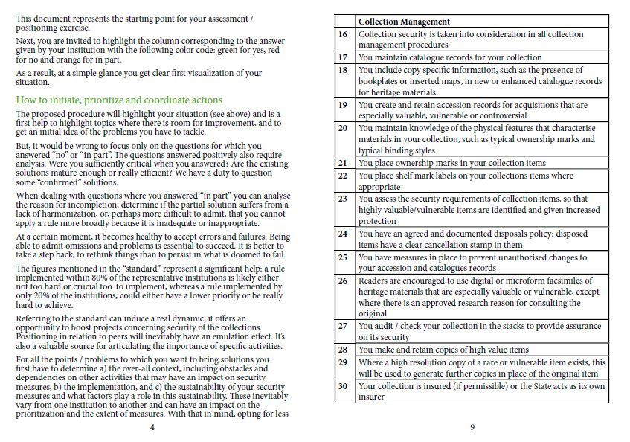
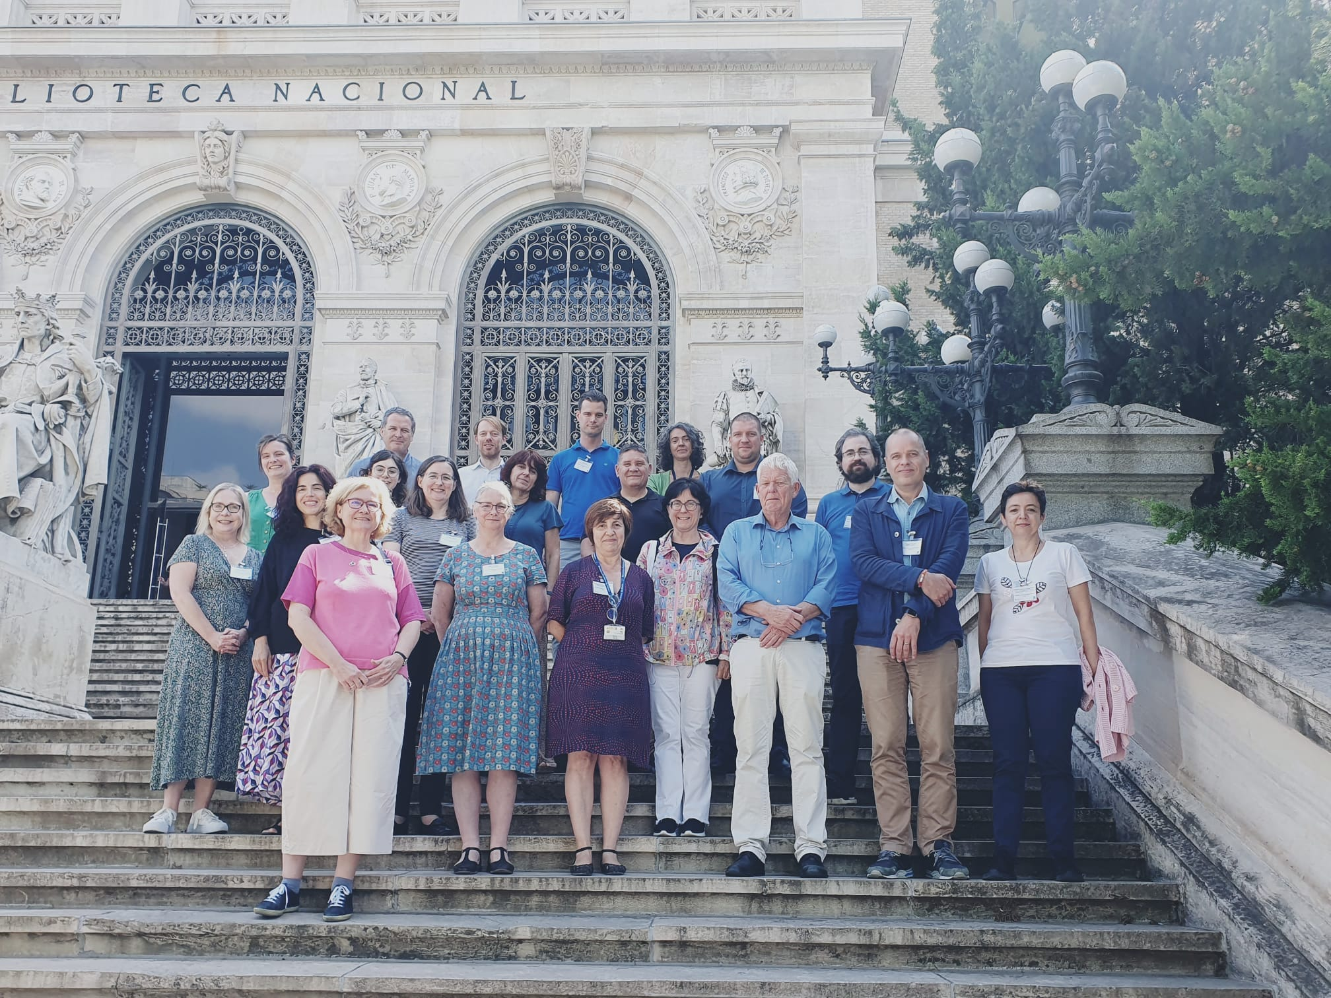

2023 Summer School
Quick Audit Tool
17

Slide 18
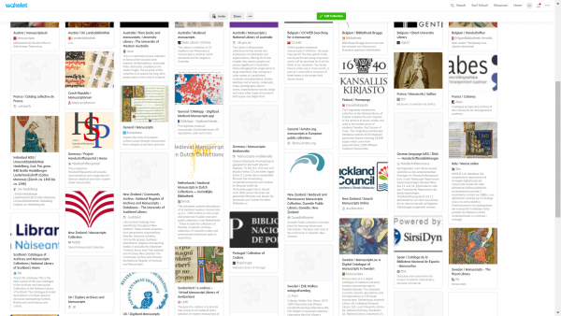
CERL is keen to support manuscript librarians and researchers,
Especially those that study manuscripts and early printed materials side by side
https://www.cerl.org/resources/cerl_and_manuscripts:

Slide 19
How to work with CERL I
Contribute data
  HPB (see https://www.cerl.org/resources/hpb/fileproc/main)
  Edit printer’s names in the CERL Thesaurus
  Describe your incunabula in MEI
  Create your own db in HPB Provenance
Use the Provenance Digital Archive to store your provenance images
Write a blog about an aspect of modern library curatorship
  1,5-2k words and lots of illustrations

Slide 20
How to work with CERL II
Suggest a theme for an online event/seminar/conference
  Sammelbände and our catalogue descriptions. How do we allow end users to understand what was bound, read, sold together?
  What do we capture about or collections and where do we store this information? In our catalogue records? The role of LOD?
  Abbeys as printing houses in Europe
  Collections from religious houses in University or National Libraries

Slide 21
How to work with CERL III
Assess your collection security by using the QAT (free!)
Attend the Collection Security Summer School 2024
Suggest a project for a CERL Grant / be a mentor
Suggest topics for PhDs, based on your collections
Join a working group or create a new one

Slide 22
CERL (and members’) News
Website: www.cerl.org
Blog posts: cerlblog.wordpress.com
Mailing list: cerl_information@lists.gbv.de
Twitter (@cerl_org and @MRL57)
Bluesky @mrlefferts.bsky.social
CERL AGM: KBR Brussels 8 November 2023, preceded by a seminar on exhibitions spaces on 7 November 2023

Slide 23
Thank you

